Slide 1
Probabilistic Clustering
MT21MCS013

Slide 2
Probabilistic clustering (aka Gaussian Mixture Model)
Unsupervised machine learning technique
Divides data into cluster
What is the right number of cluster?

Slide 3
Gaussian Mixture Model (GMM) algorithm
Can get probability associated with each cluster for given cluster
Algorithm consist of two primary steps :
Expectation
Maximization

Slide 4
GMM Algorithm (Cont…)
Expectation - for each data point ‘p’ calculate that what is the probability that point ‘p’ belongs to cluster ‘c’.
Maximization - adjust the mean, variance, and weight of each data point to maximize the possibility

Slide 5
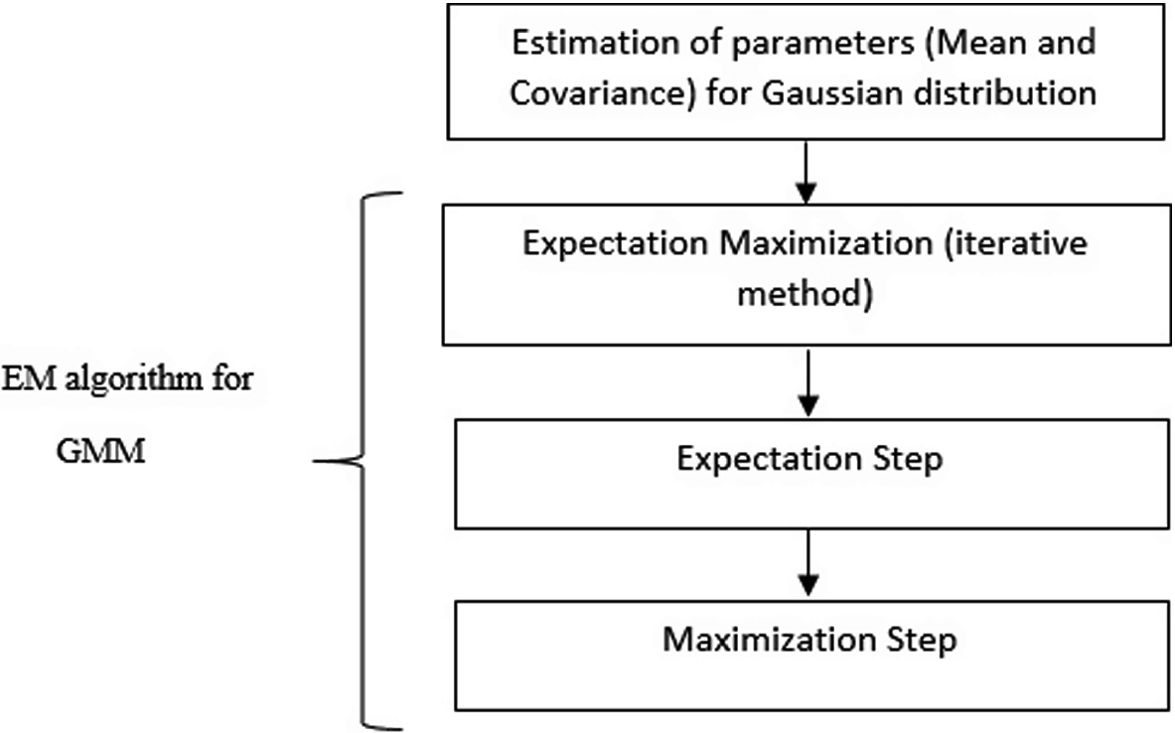
GMM Flow chart

Slide 6
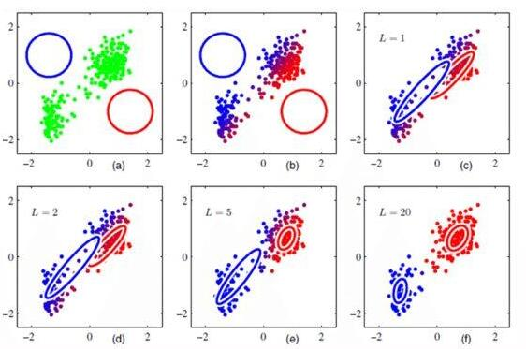

Slide 7
Reference
[1] Image - GMM Algorithm https://media.springernature.com/original/springer-static/image/chp%3A10.1007%2F978-981-13-7403-6_1/MediaObjects/469174_1_En_1_Fig3_HTML.png
[2] Image - GMM L=1 to L=20 https://www.analytixlabs.co.in/blog/wp-content/uploads/2020/07/image-14-1-600x450.jpg

